Slide 1








JOURNAL OF GRADUATE MEDICAL EDUCATION
Cost of In-person vs. Virtual Interview
INTRODUCTION In-person residency interviews are expensive but helpful for program perception. Do virtual interviews (VI) have decreased applicant costs compared to in-person interviews (IPI), and is it at the expense of program perception?
METHODS
Design: single-center, multi-specialty study comparing IPI vs. VI (2020-21)
Who: 4th year medical students and PGY1 residents (n=252)
What: survey compared 3 items:
RESULTS
VI
IPI
LIMITATIONS
1,000
$
Subject to recall bias
3,200
$
Large, urban program may not be representative
3.3/5
4.1/5
May be confounded by COVID pandemic
2,133
$
Interview costs
Program perception
Potential debt
6,825
27% response rate with PGY1s
$
CONCLUSION Virtual interviews save applicants thousands of dollars at the expense of their perception of the residency program. The authors identified several key areas programs should focus on during VI to enhance program perception.
Wang, Sheri, et al. “Virtual Residency Interviews Associated with Lower Applicant Costs but at the Expense of Program Perception: A Cross-Sectional Survey Study.” Journal of Graduate Medical Education, 999 Dec. 2022, https://doi.org/DOI***.

Slide 2







JOURNAL OF GRADUATE MEDICAL EDUCATION
Avatar Patients for Teaching Communication
INTRODUCTION Simulation helps assess resident communication, but pediatric standardized patient simulation has limitations. This study assesses the acceptability, relevance, and semblance of realness of avatar patients (APs).
METHODS
Design: 2 AP scenarios representing issues of medical ambiguity
Who: pediatric residents at one institution (n=89) from 2019-2021
What: survey evaluated 4 domains:
RESULTS
73% response rate
LIMITATIONS
High cost of program ($50,000 start up + $140/session)
78.7%
80.3%
Single center with one program may not be representative
65.5%
Emotional investment
Some survey questions may be considered leading
Realism
Helpful for learning
Comfortable for assessing competence
66.7%
CONCLUSION Pediatric residents were emotionally invested in the AP experience, found it to be realistic, and rated it as beneficial for learning and acceptable to be used for assessment of how to communicate medical ambiguity.
Frey-Vogel et al. “The Acceptability of Avatar Patients for Teaching and Assessing Pediatric Residents in Communicating Medical Ambiguity.” Journal of Graduate Medical Education, Dec. 2022, DOI: http://dx.doi.org/10.4300/JGME-D-22-00088.1

Slide 3
JOURNAL OF GRADUATE MEDICAL EDUCATION
Cost of In-person vs. Virtual Interview
INTRODUCTION In-person residency interviews are expensive, but helpful for developing a perception of a program. Are virtual interviews (VI) associated with decreased costs for applicants compared to in-person interviews (IPI), and is it at the expense of program perception?
METHODS
Design: single-center, multi-specialty study comparing IPI vs. VI from 2020-2021
Who: 4th year medical students and PGY1 residents (n=252)
What: using a one-time survey of IPI vs. VI, compared: 1) interview costs 2) program perception 2) calculated potential debt accrual for both 3 and 7-year residencies
Who: 4th year medical students and PGY1 residents (n=252)
CONCLUSION
RESULTS (VI vs IPI)
(1) costs: $1,000 vs $3,200 (p<0.001) (2) perception: 3.4/5 vs 4.1/5 (p<0.001) (3) debt accrual: $2,122 vs $6,825
LIMITATIONS
Retrospective, subject to recall bias
Large, urban residency may not be representative of more rural programs
May be confounded by COVID
FUTURE DIRECTIONS
Determining which details (e.g., city, daily life) provide applicants the most authentic representation of the residency program
Virtual interviews save applicants thousands of dollars but comes at the expense of their perception of the residency program.
Wang, Sheri, et al. “Virtual Residency Interviews Associated with Lower Applicant Costs but at the Expense of Program Perception: A Cross-Sectional Survey Study.” Journal of Graduate Medical Education, 999 Dec. 2022, https://doi.org/DOI***.

Slide 4



JOURNAL OF GRADUATE MEDICAL EDUCATION
Cost of In-person vs. Virtual Interview
INTRODUCTION In-person residency interviews are expensive, but helpful for developing a perception of a program. Are virtual interviews (VI) associated with decreased costs for applicants compared to in-person interviews (IPI), and is it at the expense of program perception?
METHODS
Design: single-center, multi-specialty study comparing IPI vs. VI from 2020-2021
Who: 4th year medical students and PGY1 residents (n=252)
What: using a one-time survey of IPI vs. VI, compared: (1) interview costs (2) program perception (3) calculated potential debt accrual for both 3 and 7-year residencies
RESULTS (VI vs IPI)
LIMITATIONS
Design: subject to recall bias; large, urban residency may not be representative of more rural programs; may have been confounded by COVID pandemic
Who: PGY1s 27% response rate; not stratified by specialty
FUTURE DIRECTIONS
Determining which details (e.g., city, daily life) provide applicants the most authentic representation of the program
Costs: $1,000 vs $3,200 (p<0.001)
Perception: 3.4/5 vs 4.1/5 (p<0.001)
Potential debt: $2,122 vs 6,825
CONCLUSION Virtual interviews save applicants thousands of dollars at the expense of their perception of the residency program. The authors identified several key areas programs should focus on during VI to enhance program perception.
Wang, Sheri, et al. “Virtual Residency Interviews Associated with Lower Applicant Costs but at the Expense of Program Perception: A Cross-Sectional Survey Study.” Journal of Graduate Medical Education, 999 Dec. 2022, https://doi.org/DOI***.

Slide 5
JOURNAL OF GRADUATE MEDICAL EDUCATION
Cost of In-person vs. Virtual Interview
INTRODUCTION In-person residency interviews are expensive, but helpful for developing a perception of a program. Are virtual interviews (VI) associated with decreased costs for applicants compared to in-person interviews (IPI), and is it at the expense of program perception?
“
METHODS
Design: single-center, multi-specialty study comparing IPI vs. VI from 2020-2021
Who: 4th year medical students and PGY1 residents (n=252)
What: using a one-time survey of IPI vs. VI, compared: 1) interview costs 2) program perception 2) calculated potential debt accrual for both 3 and 7-year residencies
Who: 4th year medical students and PGY1 residents (n=252)
LIMITATIONS
Subject to recall bias
Large, urban residency may not be representative of more rural programs
May have been confounded by COVID pandemic
FUTURE DIRECTIONS
Determining which details (e.g., city, daily life) provide applicants the most authentic representation of the program
CONCLUSIONS
VI are more affordable but come at the cost of decreased program perceptions and decreased satisfaction.
This could be a way to create a visual abstract for a perspective piece or for a qualitative study with quotes.
ATTRIBUTION
Wang, Sheri, et al. “Virtual Residency Interviews Associated with Lower Applicant Costs but at the Expense of Program Perception: A Cross-Sectional Survey Study.” Journal of Graduate Medical Education, 999 Dec. 2022, https://doi.org/DOI***.

Slide 6
JOURNAL OF GRADUATE MEDICAL EDUCATION
Cost of In-person vs. Virtual Interview
INTRODUCTION In-person residency interviews are expensive, but helpful for developing a perception of a program. Are virtual interviews (VI) associated with decreased costs for applicants compared to in-person interviews (IPI), and is it at the expense of program perception?
“
METHODS
Design: single-center, multi-specialty study comparing IPI vs. VI from 2020-2021
Who: 4th year medical students and PGY1 residents (n=252)
What: using a one-time survey of IPI vs. VI, compared: 1) interview costs 2) program perception 2) calculated potential debt accrual for both 3 and 7-year residencies
Who: 4th year medical students and PGY1 residents (n=252)
This could be a way to create a visual abstract for a perspective piece or for a qualitative study with quotes.
This could be a way to create a visual abstract for a perspective piece or for a qualitative study.
ATTRIBUTION
Wang, Sheri, et al. “Virtual Residency Interviews Associated with Lower Applicant Costs but at the Expense of Program Perception: A Cross-Sectional Survey Study.” Journal of Graduate Medical Education, 999 Dec. 2022, https://doi.org/DOI***.

Slide 7
For reference

Slide 8
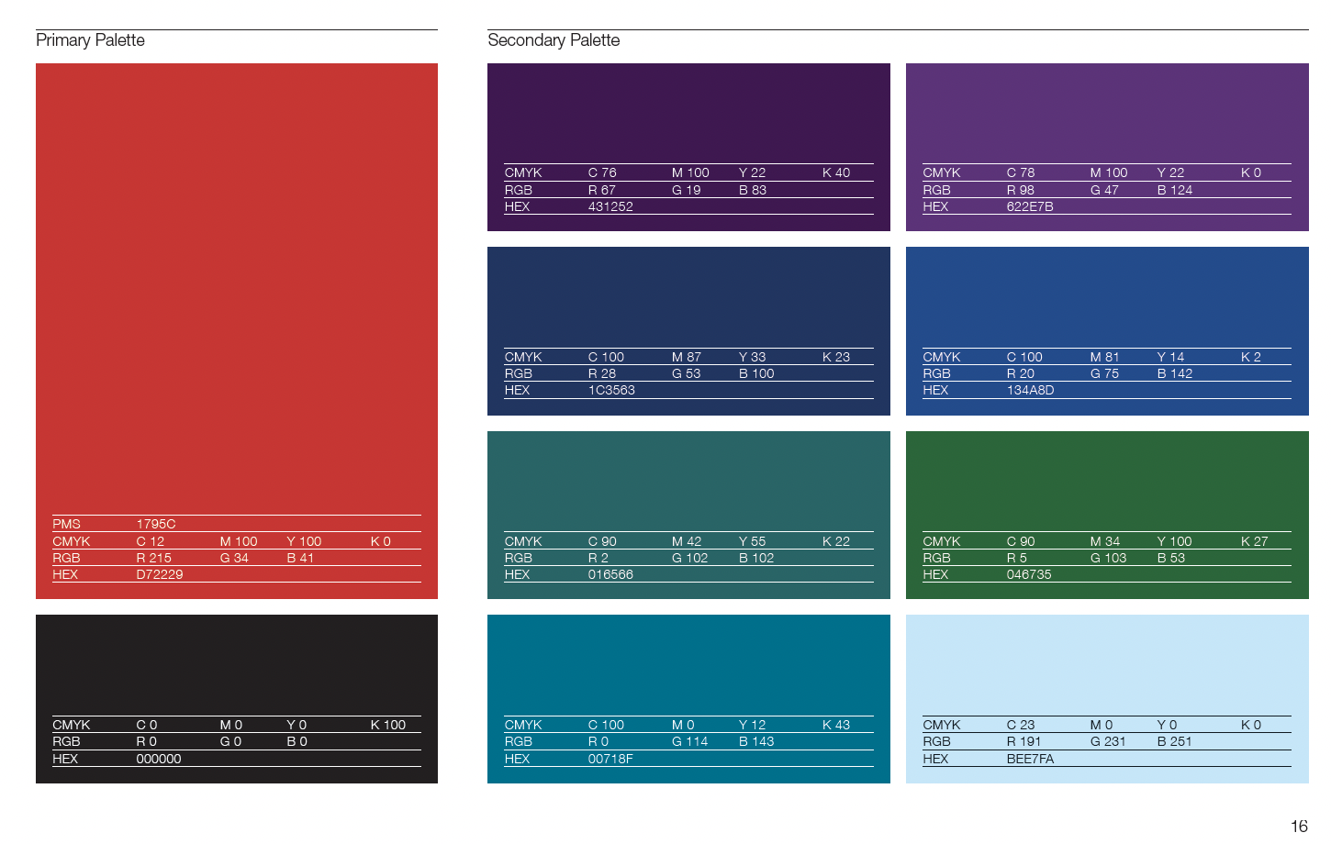

Slide 9


